Slide 1
Regression Test Suite Optimization
January 05, 2017

Slide 2
Executive summary
  Objective
    Identify ways to optimize automated regression suite for both Auto and Property products with major focus on reduction of test cases for States/Functional areas/Products that are not of high business criticality to the Client
  High Level Approach
    Carry out Risk Profiling for state and product combinations based on inputs like production policy distribution, regression defects, production defects, transaction related data etc.
    Categorize the state – product combinations into high, medium and low risk profiles
    Determine criteria and approach for optimization for different product and risk priority combinations
    Validate the various approaches with Client and based on the feedback implement the same for optimization

Slide 3
Optimization : Current Status
Apply various reduction strategies and eliminate the tests across Deloitte and EIS automated regression test suite.
Description | Total Automated
 | #TS | #TC
Total Regression base | 3549 | 21221
Optimization phase 1 reduction | 524 | 876
Optimization phase 2 - Low and Medium priority auto suite reduction | 446 | 958
Optimization phase 2 – High priority auto and low priority property (proposed) | 413 | 1507
Total Scenarios optimized from regression | 1383 | 3341
Actual reduction% identified | 39% | 16%
  Status
    State profiling based Reduction – Based on Client’s comment, Delta coverage has been identified for Medium and low risk priority states. 446 scenarios (948 test cases ) have been optimized from auto regression suite
    Delta related coverage gaps have been identified for the low and medium priority state delta for auto products
    413 more scenarios have been identified for optimization from both auto and property and are awaiting approval
    Heat maps for various views have been created in order to determine the breath of coverage for a specific state
  Actions
    Team is working on approach to identify strategy to eliminate scenarios based on state-L2 coverage for a given combination
    Team is working on new approaches to identify optimization candidates for CL and high priority scenarios in Property
    Business input is required related to hpw to identify changes that are configuration related and determine priority based on functionality
    Automated document testing approach is being finalized. Inputs required from business team regarding business priority of various auto and property related documents
  Issues
    Detailed traceability related to requirement and correct L1-L2 not present for scenarios created prior to PAS4
    Limited information on precise mapping of state wise delta functionality to user stories
  Impact
    The removal of scenarios as part of extreme optimization have helped the early regression team save on 119 script fixes for PAS 11
    82 scenarios of the 446 failed in the last build they ran during PAS10 executions
    Removal of 446 scenarios should also help in server optimization and nightly executions (pending activity)
*TC counts as of PAS8 release
# TC count as of PAS9 release

Slide 4
Optimization : High Level Plan
The High level plan is based on dividing the Regression suite in to 6 main categories as below
Category No | Scenario Category | Basic approach | Optimization status | Estimated End Date
1 | Auto scenarios optimization - CL and High Priority states | Removing duplicates for all CL and Delta functionality being covered CL, AZ, NJ and OK | In progress | 13-Jan-17
2 | Auto scenarios optimization - CA | Removing duplicates for all CA auto scenarios including CA choice and CA select products | Complete | 16-Dec-16
3 | Auto optimization - Other States | Taking product specification document as the base, retaining only delta scenarios for Low and medium priority states | Complete
4 | Property suite optimization : CL and High Priority states | Removing duplicates for all CL and Delta functionality being covered for the states (HO and PUP) | In progress | 13-Jan-17
5 | Property Optimization : CA | Removing duplicates for all CL and Delta functionality being covered for the CA (HO and PUP) | Complete | 22-Dec-16
6 | Property Optimization - Other States | Taking product specification document as the base, retaining only delta scenarios for states other than high priority and CA | On hold | 30-Dec-16
Note:
Prioritization of states for auto product has been done based on Production policy distribution and Regression defect detection post PAS4
As property state roll outs are in progress, prioritization based on production data is not suitable
States where business is expecting the highest volume of homeowner policies will be considered as High priority states
The estimated end dates are tentative and subject to change based on complexity of task or resource availability.

Slide 5
Optimization : Detailed Plan
Details of various approaches for extreme optimization and high level estimates
# | Task category | Task | #TS Impacted | #TC Impacted | Total Man-days | Estimated TS reduction # | Actual #TS reduction | Actual #TC reduction | Task status | Estimated Start Date | Estimated End Date
1.1 | Auto scenarios optimization - CL and High Priority states | Check for duplicates between DC and EIS for all AZ(CL) auto scenarios | 319 | 679 | Task completed | 150 | 172 | 451 | Finalized
1.2 |  | Delta mapping and duplicate checks for NJ and OK | 53 | 124 | Task completed | 15 | 12 | 18 | Finalized
2 | Auto Optimization - CA | Check for duplicates between DC and EIS for all CA auto scenarios | 126 | 387 | Task completed | 50 | 18 | 54 | Finalized
3 | Auto Optimization - Other States | Retaining only Delta scenarios for all states and identification of Delta coverage gaps in regression suite | 584 | 1331 | Task completed | 446 | 446 | 948 | Approved & Optimized
4.1 | Property suite optimization - CL and High Priority states | CL property redundancies with DC and EIS suite | 256 | 544 |  | 100 | 29 | 49 | In progress | 19-Dec-16 | 13-Jan-17
4.2 |  | Delta mapping and duplicate checks states identified as high priority | 144 | 463 |  | 75 | 5 | 6
5.1 | Property Optimization - CA | CA property CTS redundancies with CPs | 38 | 131 | Task completed | 25 | 21 | 54 | Finalized
5.2 |  | CA property redundancies with EIS (HO + PUP) | 215 | 835 | Task completed | 100 | 48 | 122 | Finalized
6.1 | Property Optimization - Other States | Evaluation of delta coverage between CPs and EIS Delta scenarios | 98 |  | Task completed | 25 | 45 | 625 | Finalized
6.2 |  | Delta level analysis from product specification document (including PUP) and identifying scenarios with Delta coverage | 300 | 1855 | 27 | 150 | 84 | 162 | On hold | 6-Dec-16 | 30-Dec-16
 | Pre-requisite and post scenario identification tasks | Collating information from Property product specification document |  |  | 3 |  |  |  | ongoing activity along with delta analysis
 |  | Updating of Property Heat map |  |  | Task completed |  |  |  | Finalized
 |  | Reporting/ consolidation of optimization scenarios for all threads impacted |  |  | 6
 |  | Maintenance of all inventory (inventory keeps updating due to scenarios moving to RCA) |  |  | 1 |  |  |  | ongoing activity - once a week
 |  | Reporting scenarios in regression only due to ADT dependencies |  |  | 2
 |  | Heat map updating post every optimization list |  |  | 6
 |  |  |  |  |  | 1136 | 880 | 2489

Slide 6
Appendix

Slide 7
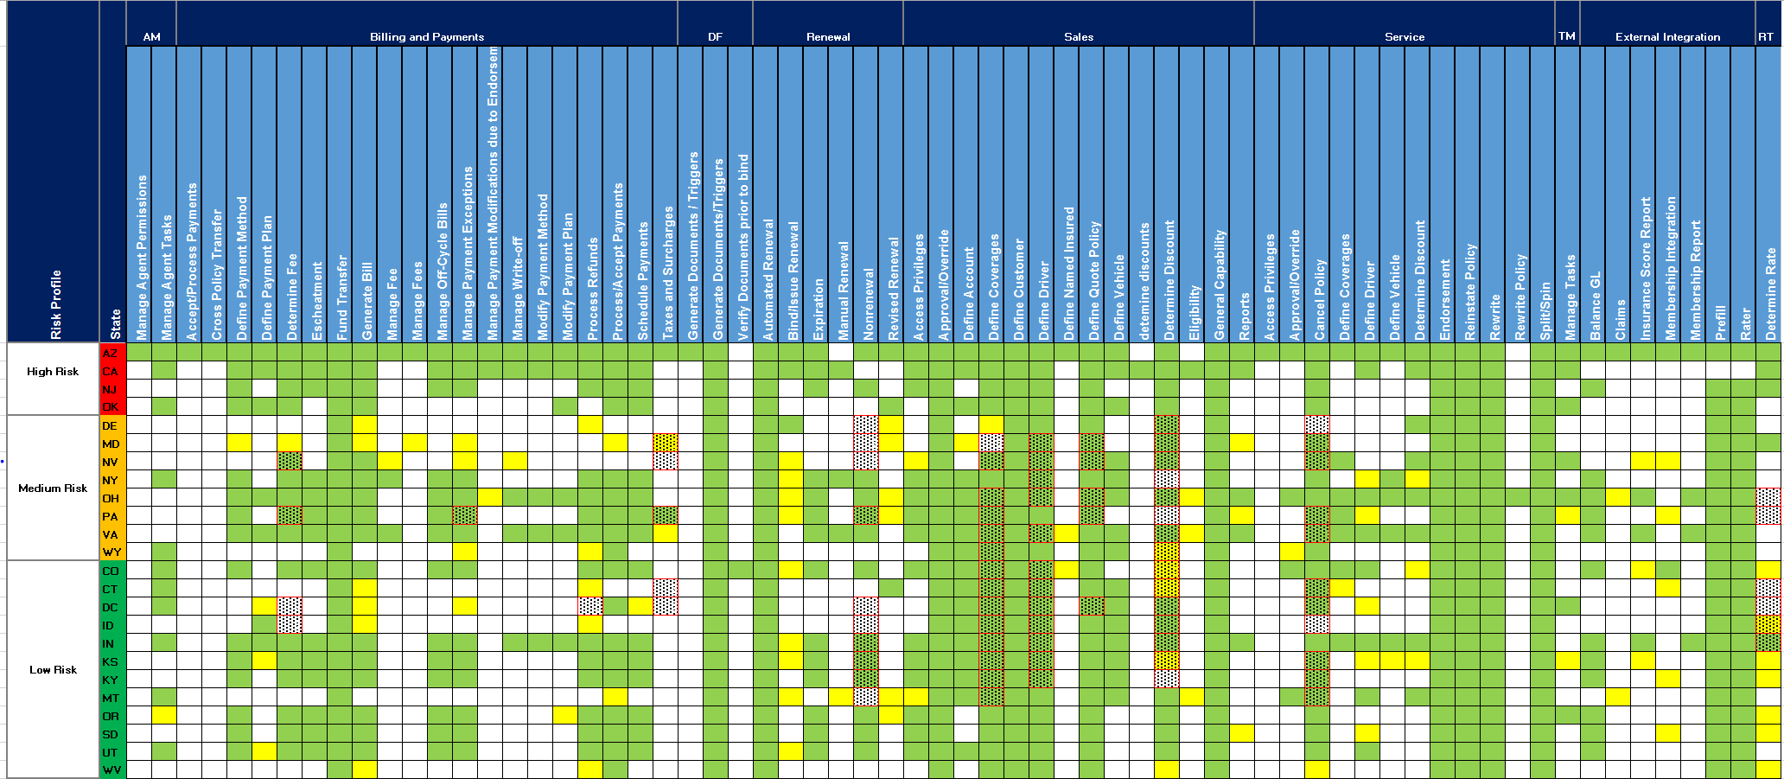
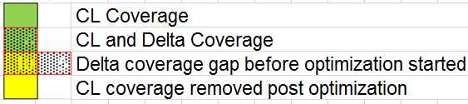
Updated Auto coverage heat map post proposed extreme optimization part 1
Heat Map of Functionalities (Function focused L2’s) and its coverage by states that are covered in the existing Auto Regression Suite

Slide 8
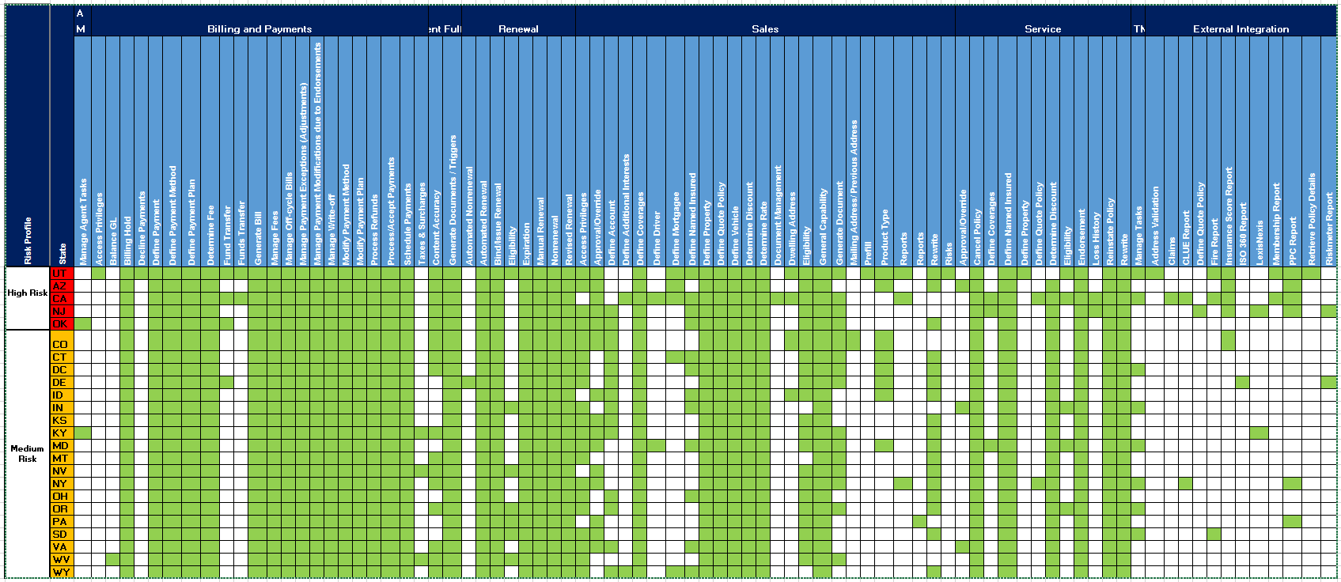
Property coverage heat map post optimization phase 1
Heat Map of Functionalities (Function focused L2’s) and its coverage by states that are covered in the existing Property Regression Suite
The above analysis includes the coverage based on the Scenario/ Test case analysis for Complete Property Regression suite including Deloitte, CTS, and EIS test Scenarios
Releases prior to PAS5 has limited information on L2 as the mapping is available for most relevant L2’s only - Additional analysis might be required to determine all relevant L2

Slide 9
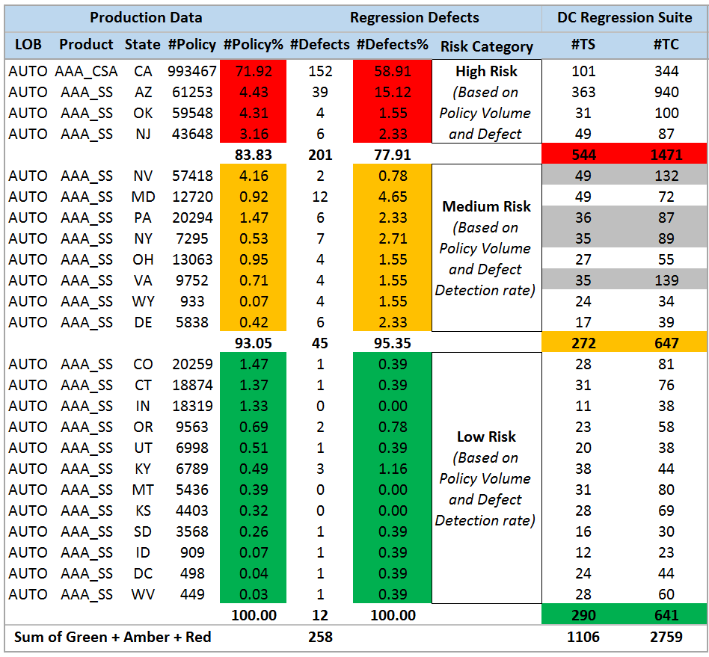
Optimization Phase 2 : Risk Profiling for Auto Product
State Risk Profiling
Approaches recommended to Client
Approach 1: Complete removal of Deloitte regression scenarios for states in low risk profile
Approach 2: Retaining of only few basic tests for all low risk states. The retained tests will have basic coverage for the L2 identified as bare minimum requirement for low risk priority states
Client Feedback: Key highlights: For Low risk states - identify the deltas for the states and cover important delta to be covered For prioritizing the Delta , connect with Business of required for their opinion on the criticality of a Delta requirement Delta where defects have been identified in past should be retained If basic functionalities are being covered by medium and high risk states, then we can deprioritize the same functionality from low priority states If the delta is very small, like change of static text for state delta, we can deprioritize it Based on the feedback, we are currently looking into ways of identifying Delta with the information available and mapping I to the Scenarios before we decide on what to optimize. There are two methods identified to Do the same. The details are in the following slides
  The above state profiling is based on Production Policy volume and QC data of defects raised by regression from PAS4 to PAS9
  Few highlights of the Low risk states is as follows:
  All scenarios from Low Risk category comprise of 26% of TS DC Auto Regression Suite
  Approximate defect detection from Low risk state regression suite is < 5%
Cells highlighted: Red – High Risk; Amber – Medium Risk; Green – Low Risk; Gray – High relative tests

Slide 10
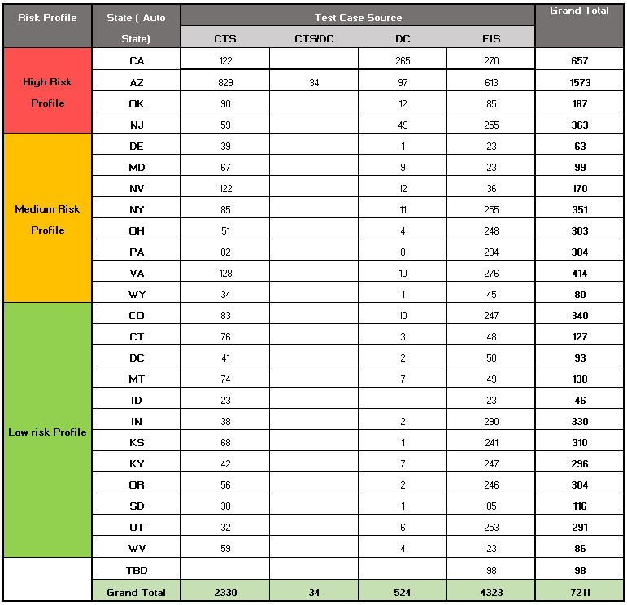

Automation Regression Suite : Total test case inventory snapshot for tests running in regression
Snapshot for automated test cases and scenario for Auto product till PAS10 Milestone 1
Test Case count for Auto product
Test Scenario count for Auto product
Cells highlighted: Red – High Risk; Amber – Medium Risk; Green – Low Risk;

Slide 11
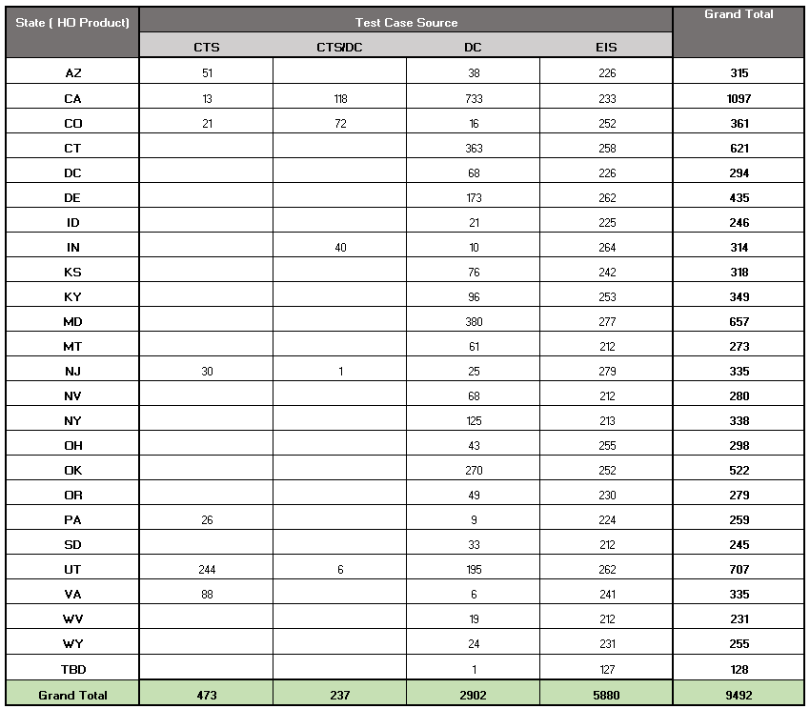
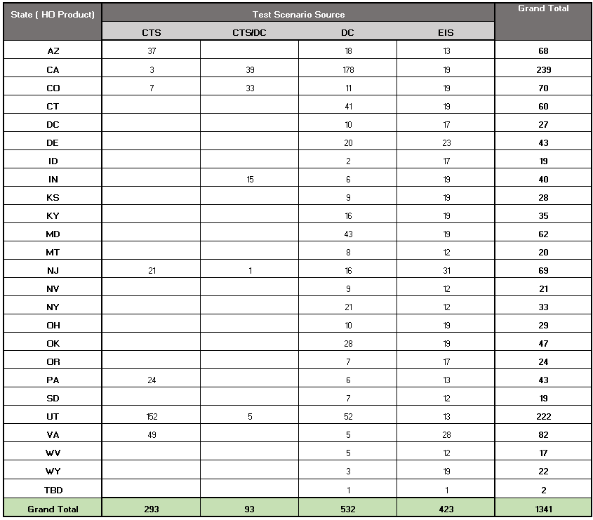
Automation Regression Suite : Total test case inventory snapshot for tests running in regression
Snapshot for automated test cases and scenario for Homeowners product till PAS10 Milestone 1
Test Case count for Homeowners product
Test Scenario count for Homeowners product

Slide 12
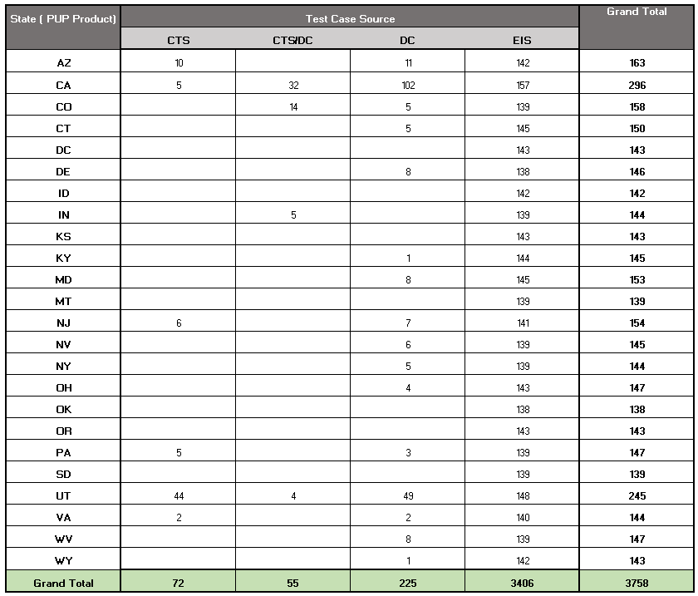
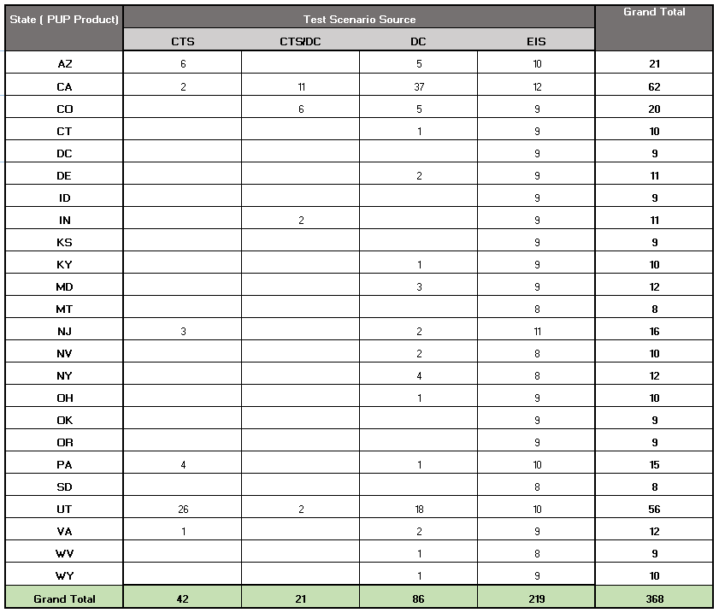
Automation Regression Suite : Total test case inventory snapshot for tests running in regression
Snapshot for automated test cases and scenario for Personal Umbrella product till PAS10 Milestone 1
Test Case count for Personal Umbrella product
Test Scenario count for Personal Umbrella product

Slide 13
Regression Test Suite Optimization – Reduction Strategies
Below are the strategies identified for potential test scenario reduction
Title | Hypothesis | Prerequisites | Assumptions | Barriers | POC Status
1 RSG | Apply Regression Scoping Guidelines to streamline test cases/scenarios Eliminate the superfluous test cases/scenarios across the states and/or products that have no delta (CL variations) | Tweak the existing regression scoping guidelines by incorporating the delta for Auto products Requirement traceability mapping for Auto test cases and for missing property test cases | Scenarios included in DC Regression suite from PAS7 release not considered for optimization as these scenarios created with the help of revised Regression scoping guidelines | Non-availability of Auto test cases Mitigation: Optimization team will directly read the code and apply the above approach | Complete ~35-40% of reduction can be achieved with this approach
2 Redundancies in CTS test cases vs PLS | Analyze the functionalities covered in Policy test cases included in Deloitte regression suite Life Cycle scenarios created by Deloitte and CTS test cases; remove the redundant validations that have no delta from CTS | Requirement traceability mapping for missing CTS property test cases in Deloitte regression suite | This approach may potentially reduce some of the scenarios that have been passed in the previous release | To be Identified | Complete ~40% of reduction can be achieved with this approach
3 Redundancies in DC and EIS suite | Analyze both Deloitte (CTS test cases added to DC regression suite before PAS5 release) and EIS regression suite and remove the redundant validations that have no delta (same state/product combinations) from Deloitte regression suite | Requirement traceability mapping for old Auto test cases and for missing property test cases in Deloitte regression suite Walk-through from EIS on the EIS regression test suite to Deloitte regression team | This approach may potentially reduce some of the scenarios that have been passed in the previous release This approach can be applied both CL and Delta functionalities across states/products | Non-availability of Auto test cases Mitigation: Optimization team will directly read the code and apply the above approach | Complete ~35-37% of reduction can be achieved with this approach
4 Redundancies in PLS vs EIS tests | Analyze the functionalities covered in Policy Life Cycle scenarios created by Deloitte and EIS test cases; remove the redundant validations that have no delta from EIS regression suite | Walk-through from EIS on the EIS regression test suite to Deloitte regression team | This approach may potentially reduce some of the scenarios that have been passed in the previous release | To be Identified | POC will be done once EIS handover process is complete
5 Retire non-time point (functional) tests | Identify and remove non-timepoint (functional) tests which are non-delta requirements by describing the coverage provided by other test types | An up-to-date product specification document clearly outlining the Delta state/product requirements | Existing coverage heat map provides the delta/non-delta situations which can be leveraged to identify non-time point (functional) and non-delta scenarios for removal | Non-availability of an up-to-date comprehensive product specification document including delta | In Progress
6 Business Validation based on Heat map | Leverage the key word search utility to derive a level 3 coverage heat map and validate with CSAA business for the right level of regression coverage |  | The individual scenarios which never failed in PAS8 & PAS9 and no defect has been raised against them can be considered as an input to this approach | To be Identified | Not started
7 Convert all possible Functional and Time point tests to Calendar | Identify individual tests which can be combined into calendar tests | Identifying the scenarios which can be combined based on the functionality, product and state |  | The never failed scenario might fail due to calendar functionality. | Not started
8 Redundancies in tests added from PASCore Releases | Eliminate the superfluous test cases/scenarios added to Regression suites from PAS Core releases | NA | Scenarios added from PASCore 6.1 release will be included for optimization analysis | To be Identified | Not started

Slide 14
Optimization Phase 1 Highlights
Apply various reduction strategies and eliminate the tests across automated regression test suite
Description | Deloitte Regression suite |  |  |  | EIS Suite |  | Total Automated
 | Added by DC Regression |  | CTS tests in DC
 | #TS | #TC | #TS | #TC | #TS | #TC | #TS | #TC
Total Regression base | 757 | 3419 | 1963 | 4193 | 754 | 13862 | 3474 | 21474
Optimization analysis as of 10/07 | 0 | 0 | 1306 | 2681 | 0 | 0 | 1306 | 2681
Scenarios identified for complete removal from regression suite | - | - | 550 | 926 | - | - | 550 | 926
Identified for reduction% as of 10/07 | - | - | 42% | 35% | - | - | 42% | 35%
Scenarios identified for Partial removal from regression suite | - | - | 173 | 383 | - | - | 173 | 383
Scenarios to be analyzed (never failed both in PAS8 & PAS9) | 757 | 3419 | 657 | 1512 | 754 | 13862 | 2168 | 18793
Number of Scenarios removed from Regression suite as of 09/16 |  |  | 524 | 876 |  |  | 524 | 876
Actual reduction% as of 10/07 | - | - | 27% | 21% | - | - | 15% | 4%
  Key highlights
    Primary focused was on removal of test scenarios that were either redundant or out of regression scoping guidelines
    15% reduction in Test scenarios from total automated regression was achieved
    Test scenarios analyzed were primarily legacy test scenarios ( handover form CTS)
    The various approaches used for the optimization were as follows:
        Apply Regression Scoping Guidelines to streamline test cases/scenarios
        Eliminate the superfluous test cases/scenarios across the states and/or products that have no delta (CL variations)
        Analyze both Deloitte (CTS test cases added to DC regression suite before PAS5 release) and EIS regression suite and remove the redundant validations that have no delta (same state/product combinations) from Deloitte regression suite
        Analyze the functionalities covered in Policy test cases included in Deloitte regression suite, Life Cycle scenarios created by Deloitte and CTS test cases; remove the redundant validations that have no delta from CTS
*TC counts as of PAS8 release
# TC count as of PAS9 release

Slide 15
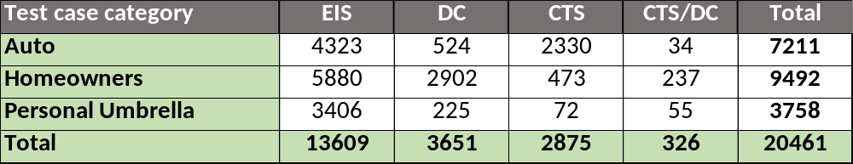
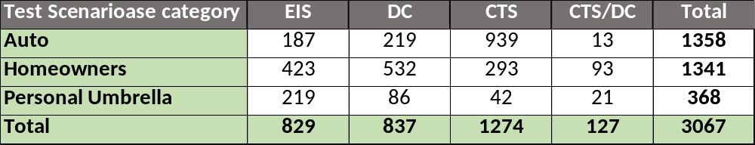
Automation Regression Suite : Total Test case & scenario inventory post Optimization Phase 1
Snapshot for automated test cases for all products and sources till PAS10 Milestone 1
Snapshot for automated test scenarios for all products and sources till PAS10 Milestone 1
    The automation inventory consists of all Factory scenarios running in nightly and all the PAS core scenarios that have been handed over to Factory for maintenance
    The test case inventory snapshot is for scenarios running in regression till PAS10 Milestone 1
    There are 4 types of test case source mentioned in the snapshot as follows:
      CTS : Test cases written and identified for regression by Cognizant team
      CTS/DC : Test cases written by Cognizant team but identified for regression by Deloitte team
      DC : Test cases written and identified for regression by Deloitte Team
      EIS : Test cases written and identified for regression by Exigen Team
    Automated tests for Browser compatibility have not been considered
    Scenarios removed as part of Optimization Phase 1 (till slot 5) have not been considered
    Test cases under TBD category in further slides ( Auto – 98 test cases / 3 scenarios, Property – 128 test cases / 2 scenarios ) need to be looked into in details to get the state information
    The risk priority is mentioned only for auto product based on the following data:
      Production policy distribution till PAS 7.1 Release
      QC data for all Regression defects from PAS4 to PAS9

Slide 16

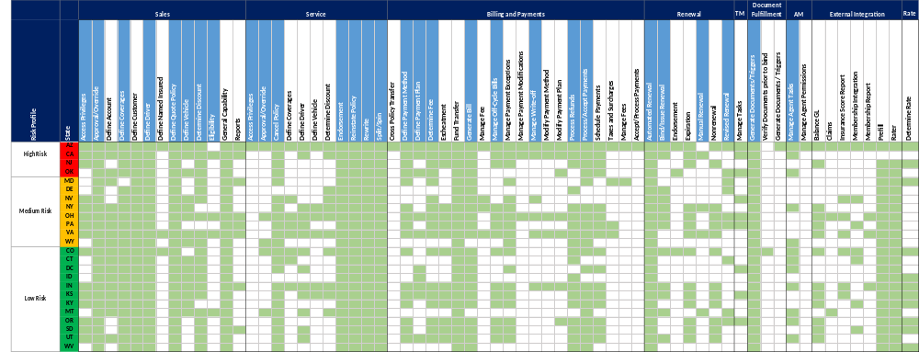
Auto Regression Coverage Heat Map
Heat Map of Functionalities (Function focused L2’s) and its coverage by states that are covered in the existing Auto Regression Suite
Rate
The above analysis includes the coverage based on the Scenario/ Test case analysis for the following:
  Complete Auto Regression suite including Deloitte, CTS, and EIS test Scenarios
  200 CTS Test Cases could not be analyzed due to unavailability of scenario document
Releases prior to PAS5 has limited information on L2 as the mapping is available for most relevant L2’s only - Additional analysis might be required to determine all relevant L2
Cells highlighted: Red – High Risk; Amber – Medium Risk; Green – Low Risk;

Slide 17
About Deloitte
Deloitte refers to one or more of Deloitte Touche Tohmatsu Limited, a UK private company limited by guarantee (“DTTL”), its network of member firms, and their related entities. DTTL and each of its member firms are legally separate and independent entities. DTTL (also referred to as “Deloitte Global”) does not provide services to clients. Please see www.deloitte.com/about for a detailed description of DTTL and its member firms. Please see www.deloitte.com/us/about for a detailed description of the legal structure of Deloitte LLP and its subsidiaries. Certain services may not be available to attest clients under the rules and regulations of public accounting.
Copyright © 2016 Deloitte Development LLC. All rights reserved.

